Slide 1
Ch 4 : Machine Learning for Finantial Stability
Youngsang Kim

Slide 2
Abstract & Intro.
Fact from global financial crisis : we need to fully understand the complex, nonlinear, time-varying, and multi dimensional nature of data.
Advantages of Advanced Machine Learning
Deal with high-dimensional datasets
Deal with unbalanced datasets & retain all of the info available
Purely data driven
Disadvantage
Black-box model

Slide 3
Machine Learning
to find a rule (algorithm) that operates on inputs in order to predict or classify units more effectively without any a priori belief about the relationships between variables.
Supervised Learning
Supervised machine learning focuses on the problem of predicting a response variable, y, given a set of predictors, x.
The goal of such algorithms is to make good out-of-sample predictions, rather than estimating the structural relationship between y and x.

Slide 4
Overview of Machine Learning Approaches
Decision Tree algorithms
decision methods based on the actual attributes observed in the explored dataset.
The objective is to derive a series of rules of thumb, visualized in a tree structure, which drive from observations to conclusions expressed as predicted values/attributes.
Regression tree (Continuous) vs Classification tree (Categorical)
Ensemble algorithms
Tree ensembles are extensions of single trees based on the concept of prediction averaging.
Boosting, Bootstrapped Aggregation (Bagging), AdaBoost, Gradient Boosting Machines (GBM), Gradient Boosted Regression Trees (GBRT). and Random Forest.
Instance-based algorithms
These methods generate classification predictions using only specific instances and finding the best match through a similarity measure between subsamples
k-Nearest Neighbor (kNN), Learning Vector Quantization (LVQ), Locally Weighted Learning (LWL), and Support Vector Machines (SVM).

Slide 5
Overview of Machine Learning Approaches
Regularization algorithms
Regularization-based models offer alternative fitting procedures to the least square method, leading to better prediction ability.
Ridge, LASSO, Elastic Net regression.
Bayesian algorithms
Apply Regression & Classification
Naive Bayes, Gaussian Naive Bayes, Multinomial Naive Bayes, Averaged OneDependence Estimators (AODE), Bayesian Belief Network (BBN), and Bayesian Network (BN).
Supervised Artificial Neural Networks (ANN)
The error between the estimation output and the target is used to adjust the weights used to connect the neurons, hence minimizing the estimation error

Slide 6
Unsupervised Learning
applies in contexts where we explore only x without having a response variable
The goal of this type of algorithm is to understand the inner structure of x, in terms of relationships between variables, homogeneous clustering, and dimensional reduction.
Clustering : given a set of observations on features, to partition the feature space into homogeneous/natural subspaces.
Networks : the goal is to estimate the joint distribution of the x variables.
Unsupervised Artificial Neural Networks (U-ANN).

Slide 7
Tree Ensembles
Advantages
good predictive accuracy
often better than that of the most widely used regression models in economics and finance
very flexible in handling problematic datasets.
main issue
black boxes.

Slide 8
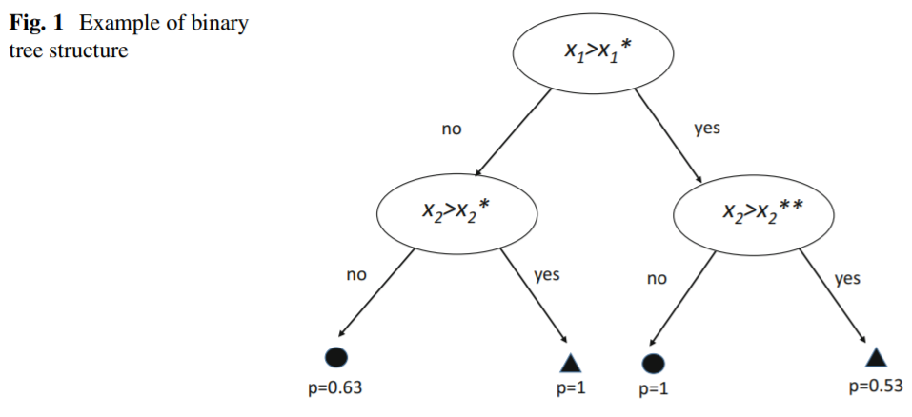
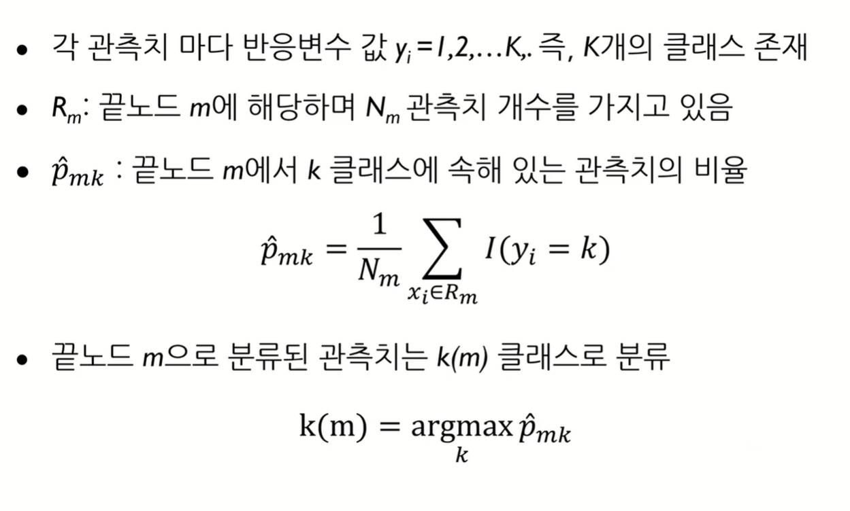
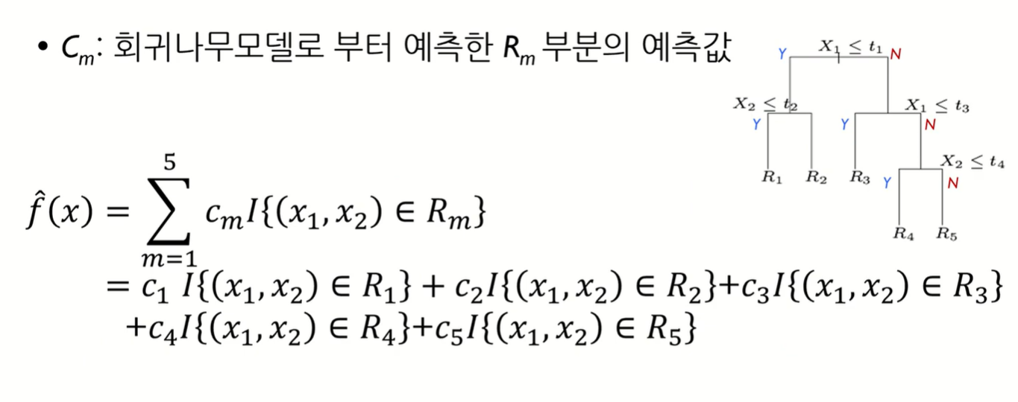
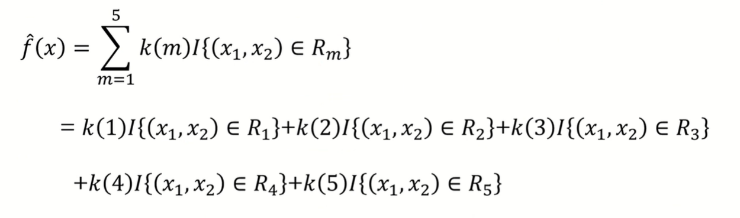
Decision Tree (DT)
nonparametric models constructed by recursively partitioning a dataset through its predictor variables, with the objective of optimally predicting a response variable.

Slide 9
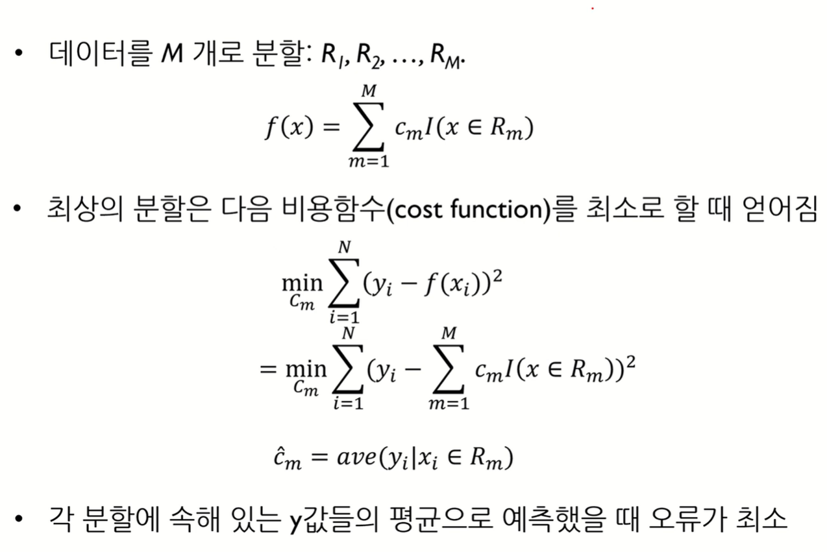
Decision Tree (DT)
For each predictor, the procedure starts by considering all the possible binary splits obtained from the sample as a whole.
The impurity of a node can be measured by the Mean Squared Error (MSE), in the case of regression trees, or the Gini index, for classification trees, or information entropy.

Slide 10
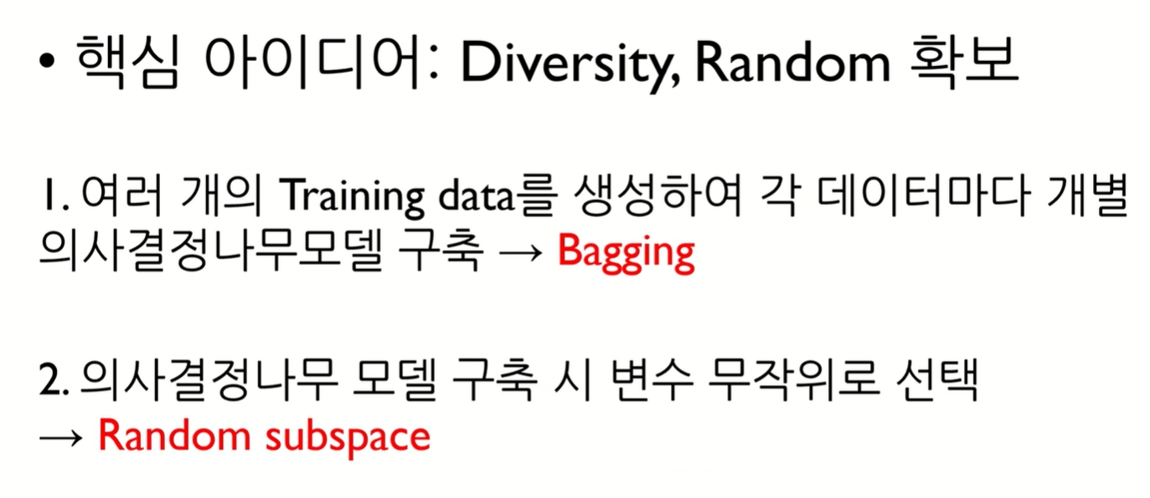
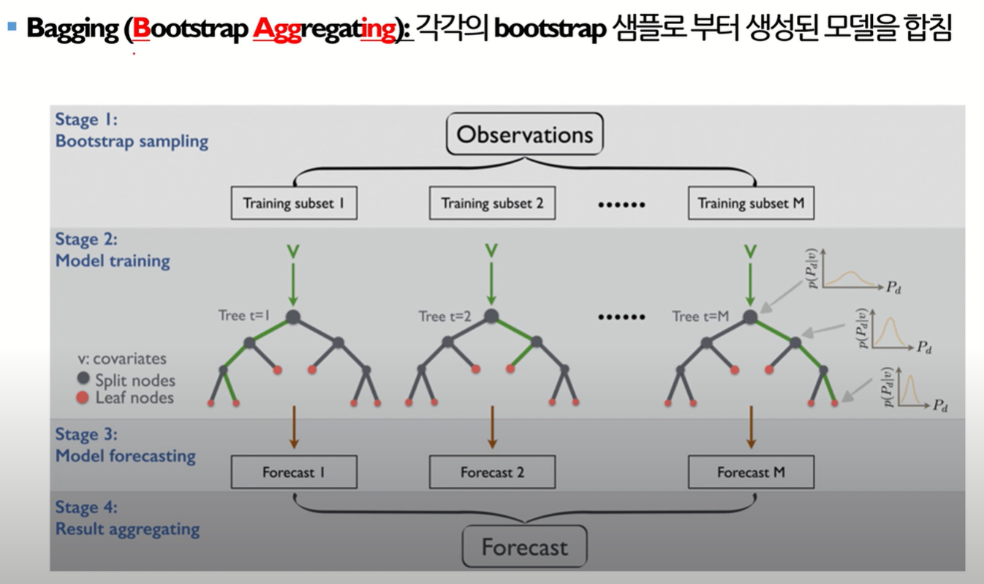
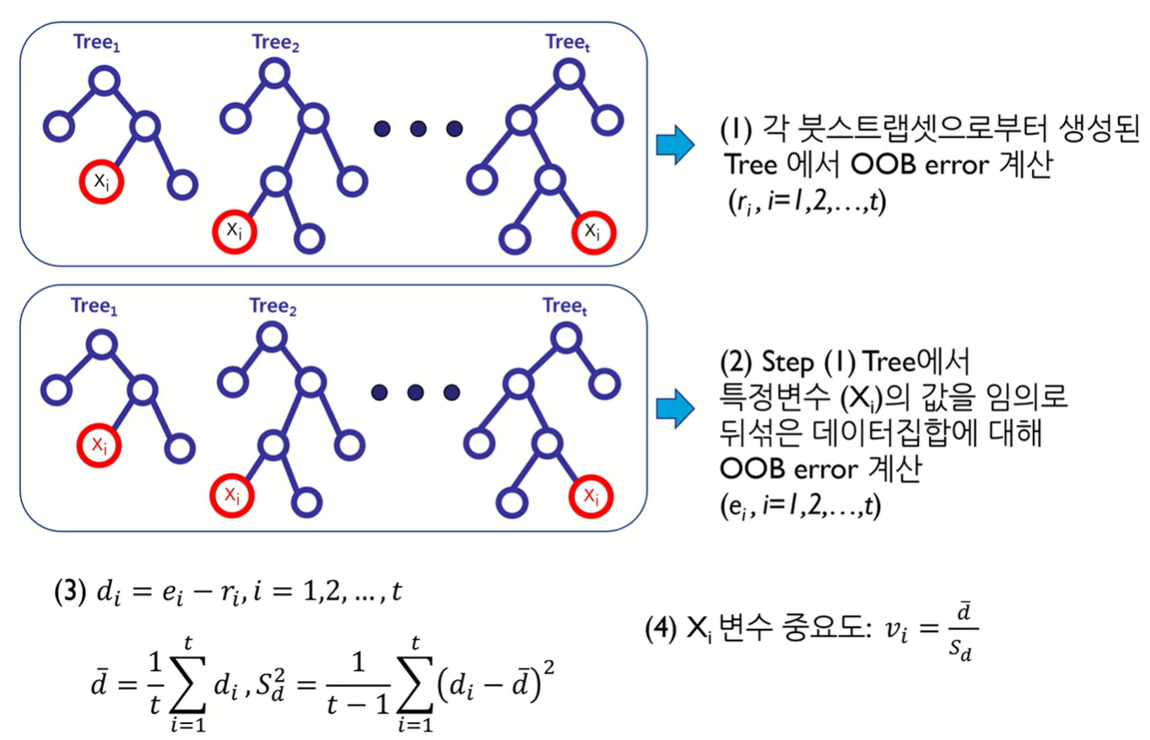
Random Forest (RF)

Slide 11
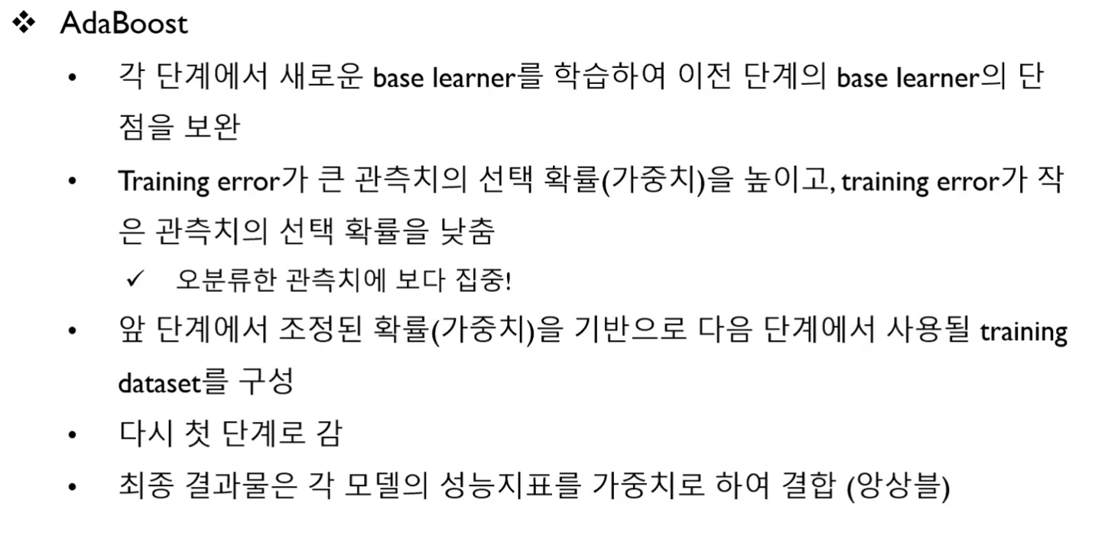
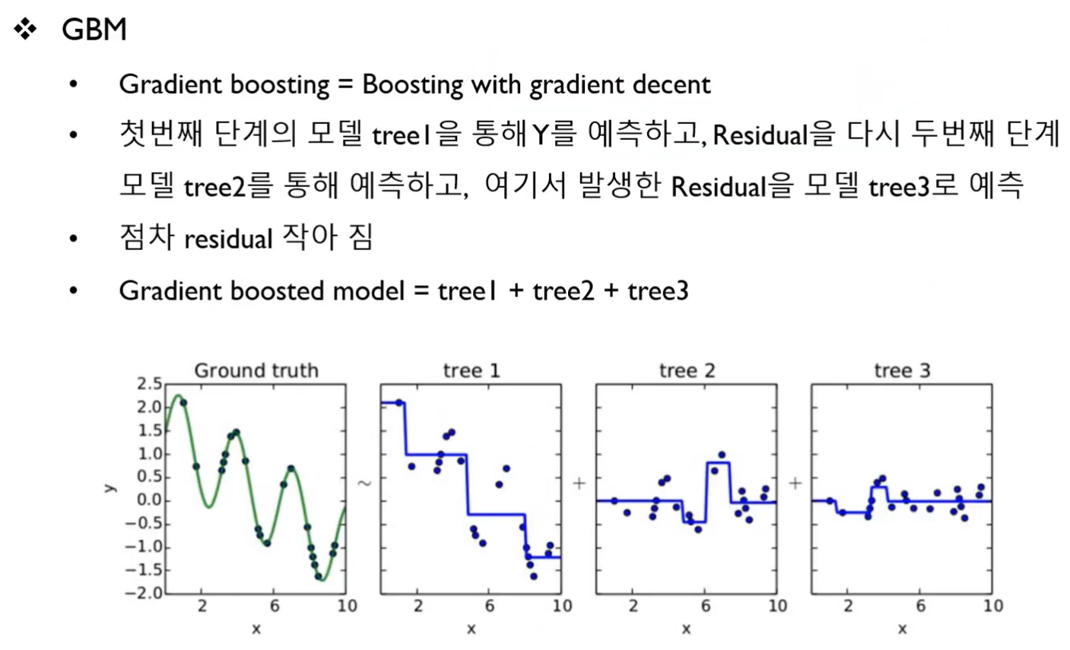
Tree Boosting

Slide 12
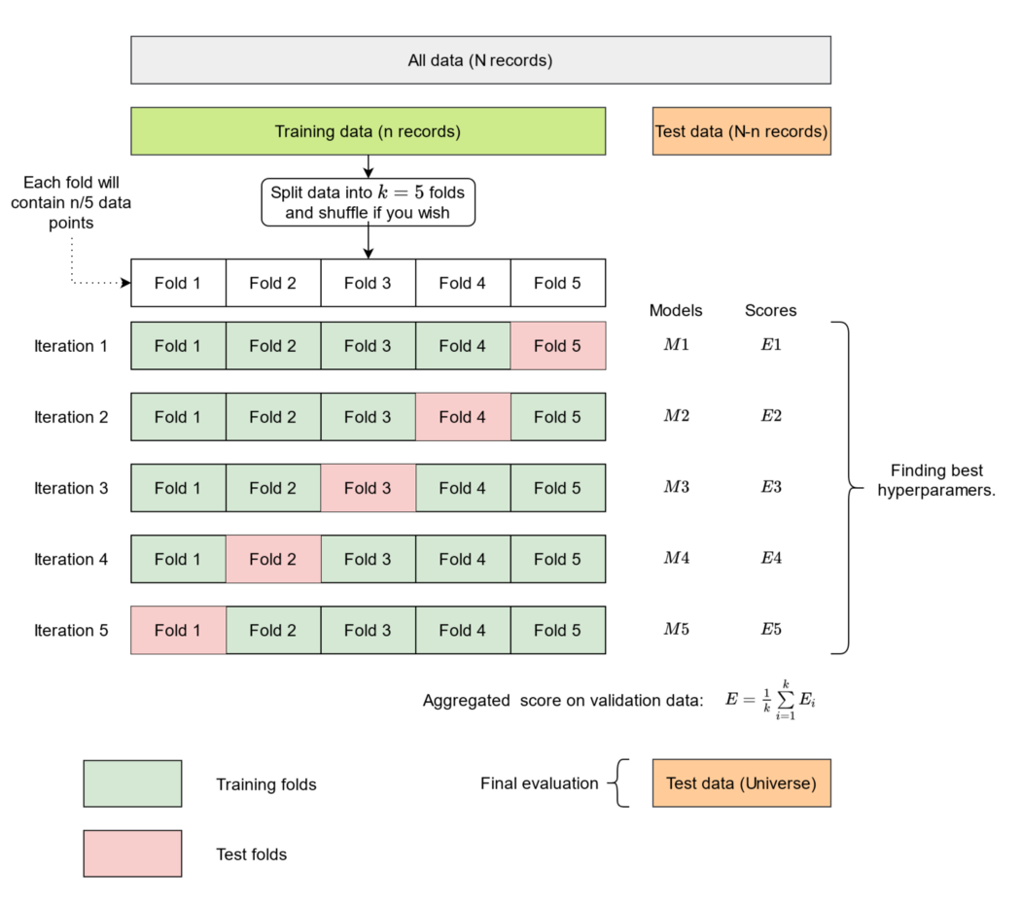
Cross-validation AGGregating
The approaches described above are designed for independent and identically distributed (i.i.d.) observations.
However, often this is not the case in economics and finance.

Slide 13
Regularization, Shrinkage, and Sparsity
standard regression models increasingly face the “curse of dimensionality.”
Sparse models offer a solution to deal with a large number of predictor variables.
LASSO-based models, Bayesian shrinkage

Slide 14
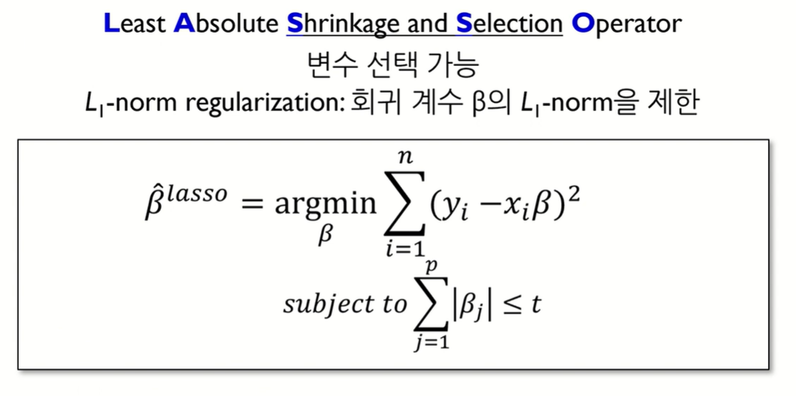
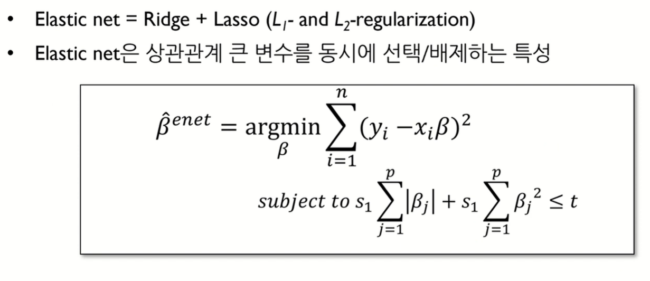
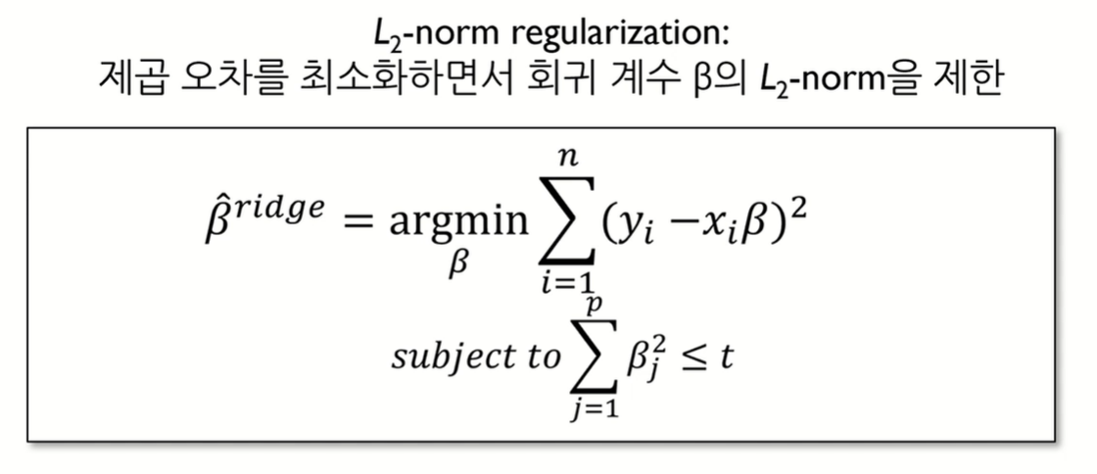
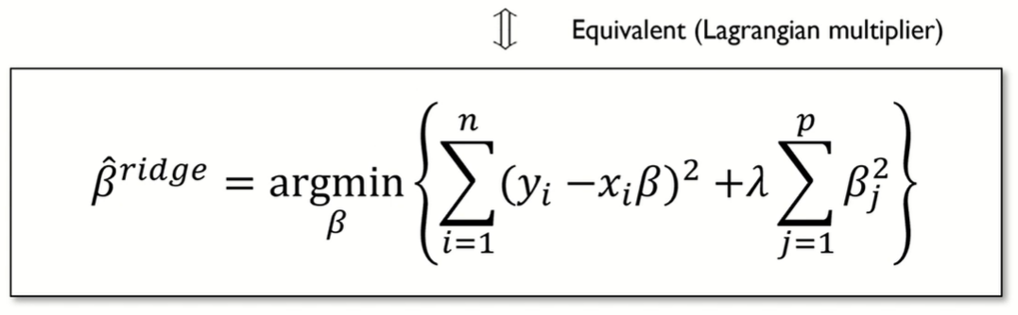
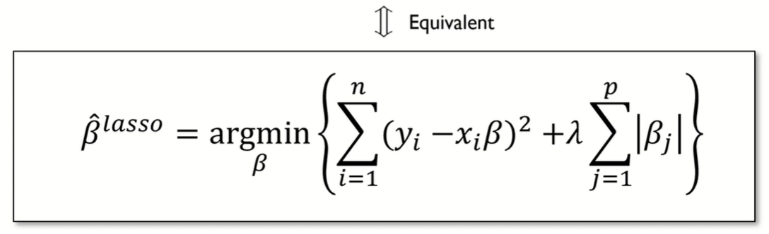
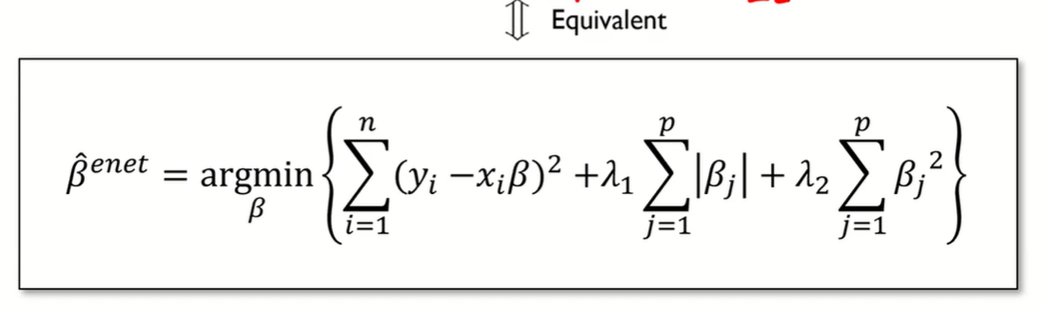
Regularization

Slide 15
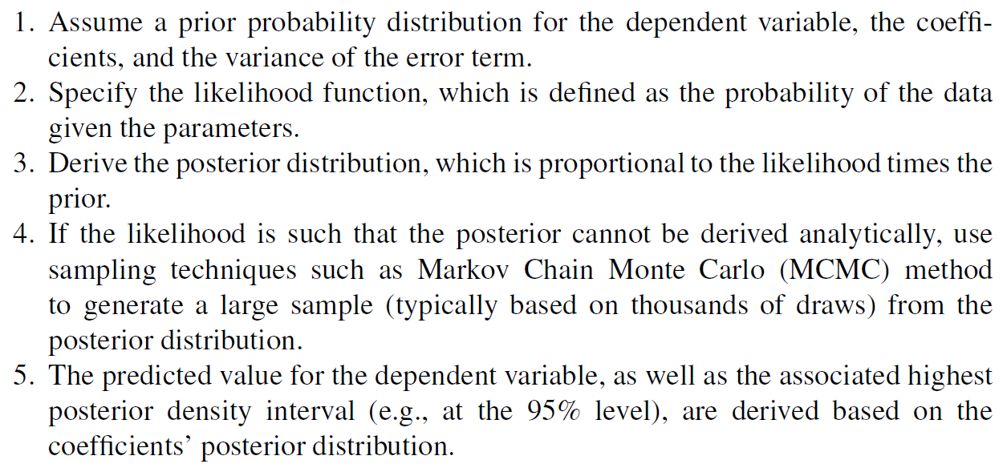
Bayesian Learning
Bayesian linear regression accounts for the uncertainty around model estimates.

Slide 16
Critical Discussion on Machine Learning as a Tool for Financial Stability Policy
standard approaches are usually unable to fully understand the risk dynamics within financial systems in which structural relationships interact in nonlinear and state-contingent ways.
machine learning algorithms also have limitations. In a sense, machine learning approaches limit their knowledge to the data they process, no matter how and why those data lead to specific models.
In more depth, machine learning is expected to say little about the causal effect between y and x, but rather it is conceived with the end to predict y using and selecting x.
To overcome the limitations of machine learning techniques, one promising avenue is to use them in combination with existing model-based and theorydriven approaches.

Slide 17
Literature Overview
This is the socalled second generation of Early Warning Models (EWM), developed after the global financial crisis.
While the first generation of EWM, popular in the 1990s, was based on rather simple approaches such as the signaling approach, the second generation of EWM implement machine learning techniques, including tree-based approaches and parametric multiple-regime models.

Slide 18
Decision Trees for Financial Stability
use of decision trees to address financial stability issues
binary classification tree to analyze banking crises in 50 emerging markets and developed economies.
They apply the CRAGGING approach to test 540 candidate predictors and identify two banking crisis’
“danger zones”: 1) when high interest rates on bank deposits interact with credit booms and capital flights 2) the second occurs when an investment boom is financed by a large rise in banks’ net foreign exposure

Slide 19
Sparse Models for Financial Stability
LASSO and Bayesian methods have so far been used in finance mostly for portfolio optimization.
investigate the determinants of the 2008 global financial crisis using a Bayesian hierarchical formulation that allows for the joint treatment of group and variable selection.

Slide 20
Unsupervised Learning for Financial Stability
Networks have been extensively applied in financial stability.
The literature applying network theory started to grow exponentially in the aftermath of the global financial crisis.
Turning to artificial neural networks, while supervised ones have been used in a few works as early warning models for financial crises, unsupervised ones are even less common in the financial stability literature.

Slide 21
Conclusion
Forecasting financial crises is essential to provide warnings to be used in preventing impending abnormalities, and taking action with a sufficient lead time to implement adequate policy measures.
The ability to discover complex and nonlinear relationships, not fully biased by a priori theory/beliefs, has contributed to getting rid of the skepticism around machine learning.
However, we should be aware about what machine learning can and cannot do, and how to handle these algorithms alone and/or in conjunction with common traditional approaches to make financial crisis predictions more statistically robust and theoretically consistent.
Also, it would be important to work on improving the interpretability of the models, as there is a strong need to understand how decisions on financial stability issues are being made.

